Slide 1

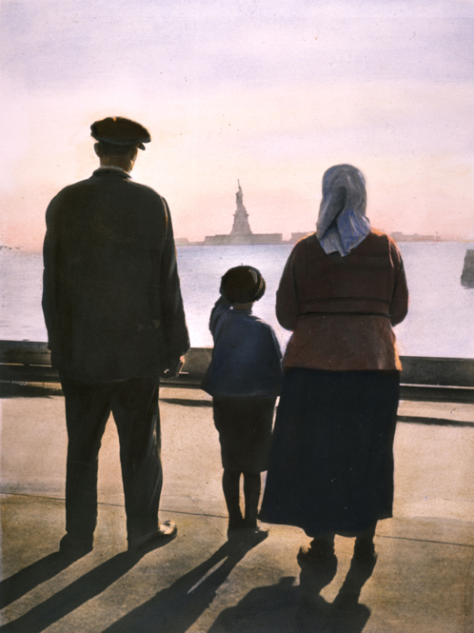
Changes in American Life,
1880–1914
American life undergoes social, economic, and cultural changes.
A family of European immigrants at Ellis Island viewing the Statue of Liberty (about 1920).
NEXT

Slide 2
Changes in American Life,
1880–1914
SECTION 1
Cities Grow and Change
SECTION 2
The New Immigrants
SECTION 3
Segregation and Discrimination
SECTION 4
Society and Mass Culture
NEXT

Slide 3

Section 1
Cities Grow and Change
Industrialization and immigration cause American cities to grow rapidly.
NEXT

Slide 4
SECTION
Cities Grow and Change
1
Industrialization Expands Cities
• Late 1880s, more people move from rural areas to cities, find jobs
• Industries are drawn to cities because of:
- good transportation, many workers
• Urbanization—growth of cities caused by:
- increasing factory jobs in cities
- workers moving to cities to fill factory jobs
Map
NEXT

Slide 5
SECTION
1
Technology Changes City Life
• Skyscrapers help cities grow, make modern city life possible
• Elevators allow tall buildings, people do not have to walk up floors
Chart
• Use of steel helps increase the height of buildings
NEXT

Slide 6
SECTION
1
The Streetcar City
• Before Industrialization, people walk, use
horse-drawn carriages
• By 1900, many people in cities use electric streetcars
Image
• Streetcars move people faster, longer distances, allow cities to expand
NEXT

Slide 7
SECTION
1
Urban Disasters and Slums
• People, buildings packed closely together, poverty, danger increases
• Many people live in tenements—run-down, overcrowded apartments
Image
• Unsafe drinking water, open sewage spreads disease in tenements
• Neighborhood with overcrowded, dangerous housing—slum
NEXT

Slide 8
SECTION
1
Reformers Attack Urban Problems
• Urban reformers seek changes, help people living in poverty, slums
• Social gospel—movement aims to improve lives of the poor
• Based on Christian values, seek labor reforms, abolish child labor
• Reformers open settlement houses, help poor, immigrants
• Jane Addams starts Hull House—settlement house, model for others
NEXT

Slide 9
SECTION
1
Political Machines Run Cities
• Political machine—influences votes to control local government
• Gains support by trading favors for votes, break rules, win elections
• Tammany Hall—famous NYC political machine, corrupt
• Political machines do some good, civic improvements, help immigrants
NEXT

Slide 10
Section 2
The New Immigrants
Millions of immigrants—mostly from southern and eastern Europe—moved to the United States.
NEXT

Slide 11
SECTION
The New Immigrants
2
The New Immigrants
• New Immigrants—arrive after 1900, include Italians, Jews, Slavs
Chart
• Ellis Island—first stop for European immigrants entering U.S.
• Angel Island—first stop for Asian immigrants entering U.S.
• Mexican immigrants enter U.S. through Texas
NEXT

Slide 12
SECTION
2
Settling in America
• Many immigrants find jobs in factories in cities
• People with similar ethnic backgrounds often move to same neighborhood
Image
• Immigrant communities publish newspapers in native languages
• Support political machines, politicians help immigrants find jobs
NEXT

Slide 13
SECTION
2
Immigrants Take Tough Jobs
• Immigrants take whatever jobs they can get
• Many European immigrants work in sweatshops in the East
• European immigrants mostly settle in East, Midwest
• Chinese immigrants mostly settle in West, railroaders, business people
• Japanese immigrants go to Hawaii, mainland U.S., fish, farm
• Mexican immigrants go to Southwest, work for growers, ranchers
NEXT

Slide 14
SECTION
2
Becoming Americans
• U.S. is described as melting pot—place where cultures blend
• Assimilation—process of blending into society
• Employers, labor unions try to “Americanize” immigrant workers
• Offer classes in citizenship, English
• Immigrant cultures, languages influence American society
• Immigrants face prejudice from native-born Americans
NEXT

Slide 15
SECTION
2
Restrictions on Immigration
• Many native-born Americans do not want immigrant competition for jobs
• In 1882, Congress begins to pass laws restricting immigration
• Chinese Exclusion Act—bans Chinese immigration for 10 years
NEXT

Slide 16
Section 3
Segregation and Discrimination
Racial discrimination runs through American society in the late 19th and early 20th centuries.
NEXT

Slide 17
SECTION
Segregation and Discrimination
3
Racism Causes Discrimination
• Racial discrimination—different treatment on the basis of race
• Low social rank of slaves leads whites to think they are superior to blacks
• Asians, Native Americans, Latin Americans face discrimination
• Racial discrimination in South very strong
NEXT

Slide 18
SECTION
3
Segregation Expands in the South
• In South, whites restrict African-American voting rights:
- force them to take unfair literacy exams,
make sure they fail
- require African Americans pay high poll tax, often unable to pay
• Use grandfather clauses to allow poor whites to vote
• Jim Crow laws enforce segregation
• Segregation—separation of white, black people in public places
Image
NEXT

Slide 19
SECTION
3
Plessy v. Ferguson
• Homer Plessy sues railroad company, argues about segregation
• Plessy v. Ferguson (1896) Supreme Court rules against Plessy:
- “separate but equal” facilities do not violate 14th Amendment
• Ruling allows Southern states to maintain segregated institutions
• Separate facilities of African Americans worse than white facilities
NEXT

Slide 20
SECTION
3
African Americans Organize
• Booker T. Washington—teacher, starts institute for African Americans
Image
• To gain white support, does not challenge segregation
• W. E. B. Du Bois—encourages African Americans to reject segregation
• Du Bois, reformers start NAACP, helps end segregation in 20th century
• NAACP—National Association for the Advancement of Colored People
NEXT

Slide 21
SECTION
3
Violence in the South and North
• In South, Ku Klux Klan violence against blacks challenging segregation
• Ida B. Wells—African American journalist, fights against lynching
Image
• In North, no segregated facilities, blacks still suffer discrimination
NEXT

Slide 22
SECTION
3
Racism in the West
• Chinese immigrants receive lower wages, face violence
• Mexicans, African Americans in Southwest forced into peonage
• Peonage—system of labor, workers forced to work to pay off debts
• Outlawed in 1867, peonage-like system still used
• U.S. Supreme Court states any peonage-like system is illegal (1911)
NEXT

Slide 23
Section 4
Society and Mass Culture
Industrialization and new technologies create a mass culture in the United States.
NEXT

Slide 24
SECTION
Society and Mass Culture
4
Education and Publishing Grow
• Education helps create an American mass culture:
- common culture experienced by large
numbers of people
• Immigration causes growth in schools, teach citizenship, English
• Number of children attending school more than doubles
• Literacy increases, reading novels, newspapers becomes popular
Chart
Continued . . .
NEXT

Slide 25
SECTION
4
continued Education and Publishing Grow
• Joseph Pulitzer—owner of the New York World
• William Randolph Hearst—owner of New York Morning Journal
• Pulitzer, Hearst tough competitors, publish sensational stories
NEXT

Slide 26
SECTION
4
Modern Advertising and New Products
• Advertising increases, tempt people to buy products
• Market advertising of household products toward women
• Department stores—sell many types of products
• Mail-order catalogs—descriptions, pictures of products, order by mail
Image
• Rural free delivery starts, packages go to homes in rural areas (1896)
NEXT

Slide 27
SECTION
4
Urban Parks and World’s Fairs
• Leisure, or free time, activities change
• Many people go to parks to get relief from factories, offices
• Amusement parks provide entertainment, shops, food, rides
Image
• World’s fairs hosted by cities, show new technology, have foods, shows
NEXT

Slide 28
SECTION
4
Spectator Sports
• Baseball, football, boxing, other sports are popular
• Baseball is most popular sport, has standardized rules, schedule
Image
• Black baseball players not allowed in American, National Leagues
• Form their own baseball leagues:
- Negro American League
- Negro National League
NEXT

Slide 29
SECTION
4
Going to the Show
• Vaudeville—shows mix song, dance, comedy, very popular
• Ragtime—blends African-American songs, European musical forms
• African-American Scott Joplin composes ragtime compositions
• In early 1890s, movies become popular, first movies are silent
Image
NEXT

Slide 30
This is the end of the chapter presentation of
lecture notes. Click the HOME or EXIT button.
NEXT

Slide 31



Print Slide Show
1. On the File menu, select Print
2. In the pop-up menu, select Microsoft PowerPoint
If the dialog box does not include this pop-up, continue to step 4
3. In the Print what box, choose the presentation format you want to print: slides, notes, handouts, or outline
4. Click the Print button to print the PowerPoint presentation
Print Text Version
1. Click the Print Text button below; a text file will open in Adobe Acrobat
2. On the File menu, select Print
3. Click the Print button to print the entire document, or select the pages you want to print
Print Text
Print Text
BACK

